Slide 1
Home Improvement Retail investment
BY Tin hang

Slide 2
Overview
Investing in housing stocks during COVID-19, such as CTRE (CareTrust REIT), HD (The Home Depot), LEN (Lennar Corporation), LGIH (LGI Homes), and NVR (NVR, Inc.), can be advantageous for several reasons:
Resilience of the Housing Market: Despite the economic downturn caused by the pandemic, the housing market has shown resilience. Low-interest rates, government stimulus measures, and changing housing needs (such as increased demand for suburban homes) have sustained demand for housing-related products and services.
Essential Nature of Housing: Housing is a fundamental need, and even during times of economic uncertainty, people still need shelter. Therefore, companies involved in various aspects of the housing sector, including home construction, renovation, and real estate investment, tend to have a more stable demand for their products and services compared to other industries.
Increased Home Improvement Spending: With many people spending more time at home due to lockdowns and remote work arrangements, there has been a surge in home improvement projects. Companies like The Home Depot (HD) benefit from this increased demand for home improvement products and services.

Slide 3
Overview (Continued)
Demand for New Homes and Rentals: Despite challenges, there's still demand for new homes and rentals, especially as people reassess their living situations due to factors like remote work, urban flight, and the desire for more space. Companies like Lennar Corporation (LEN), LGI Homes (LGIH), and NVR, Inc. (NVR) are well-positioned to capitalize on this demand.
Potential for Long-Term Growth: Investing in housing stocks during COVID-19 can also be seen as a long-term play. Once the pandemic subsides and economic conditions stabilize, the housing market is likely to continue its growth trajectory, driven by factors such as population growth, urbanization trends, and pent-up demand.
Diversification Benefits: Including housing stocks in an investment portfolio can provide diversification benefits, as the housing sector often behaves differently from other sectors of the economy. This can help reduce overall portfolio risk.

Slide 4
Homes Companies profile
CareTrust REIT, Inc. (CTRE):
Establishment: Founded in 2014.
IPO: Went public on June 2, 2014.
Market Cap: Approximately $3.5 billion (as of September 2022).
The Home Depot, Inc. (HD):
Establishment: Founded in 1978.
IPO: Went public on September 22, 1981.
Market Cap: Over $300 billion (as of September 2022).
Lennar Corporation (LEN):
Establishment: Founded in 1954.
IPO: Went public on November 3, 1971.
Market Cap: Over $26 billion (as of September 2022).

Slide 5
Homes Companies profile
LGI Homes, Inc. (LGIH):
Establishment: Founded in 2003.
IPO: Went public on November 7, 2013.
Market Cap: Approximately $2.5 billion (as of September 2022).
Lowe's Companies, Inc. (LOW):
Establishment: Founded in 1946.
IPO: Went public on August 18, 1961.
Market Cap: Over $130 billion (as of September 2022).
NVR, Inc. (NVR):
Establishment: Founded in 1980.
IPO: Went public on February 1, 1986.
Market Cap: Over $21 billion (as of September 2022).

Slide 6
CareTrust REIT, Inc. (CTRE)
Strengths:
Diversified portfolio of healthcare properties, including skilled nursing facilities and senior housing.
Strong financial performance with consistent revenue growth.
Focus on strategic acquisitions to expand the portfolio.
Weaknesses:
Vulnerability to changes in healthcare regulations and policies.
Dependency on rental income from healthcare operators.
Exposure to risks associated with healthcare industry dynamics.
Opportunities:
Aging population trend increasing demand for healthcare services.
Expansion into new markets with favorable demographics.
Potential for partnerships with healthcare providers for innovative solutions.
Threats:
Regulatory changes impacting reimbursement rates and healthcare spending.
Competition from other REITs and healthcare real estate developers.
Economic downturn affecting occupancy rates and rental income.

Slide 7
The Home Depot, Inc. (HD)
Strengths:
Market leader in the home improvement retail industry.
Strong brand reputation for quality products and customer service.
Extensive store network providing convenient access to customers.
Weaknesses:
Dependency on the housing market and consumer spending.
Vulnerability to seasonal fluctuations in sales.
Increasing competition from online retailers.
Opportunities:
Growth potential in e-commerce and omnichannel retailing.
Expansion into new product categories or services.
International market expansion.
Threats:
Economic downturn affecting consumer spending on home improvement.
Increasing competition from traditional rivals and new entrants.
Supply chain disruptions impacting inventory availability.

Slide 8
Lennar Corporation (LEN)
Strengths:
Diversified homebuilding and real estate services portfolio.
Strong brand presence in the housing market.
Focus on innovation and sustainability in home construction.
Weaknesses:
Vulnerability to cyclical fluctuations in the housing market.
Exposure to regulatory changes impacting the real estate industry.
Dependency on mortgage financing availability.
Opportunities:
Growth potential in affordable housing segment.
Expansion into new geographic markets.
Integration of smart home technology and sustainable building practices.
Threats:
Economic downturn affecting housing demand and home prices.
Rising construction costs impacting profit margins.
Regulatory changes impacting land use and zoning.

Slide 9
LGI Homes, Inc. (LGIH)
Strengths:
Focus on entry-level and move-up homebuyers.
Efficient homebuilding operations driving cost advantages.
Geographic diversification across high-growth markets.
Weaknesses:
Dependency on economic conditions and mortgage market.
Exposure to land acquisition and development risks.
Limited brand recognition compared to larger competitors.
Opportunities:
Expansion into new markets with strong housing demand.
Diversification into related real estate services.
Adoption of innovative marketing strategies to reach target customers.
Threats:
Economic downturn impacting homebuyer affordability and demand.
Regulatory changes affecting land development and construction.
Competition from larger homebuilders with greater resources.

Slide 10
Lowe's Companies, Inc. (LOW)
Strengths:
Strong presence in the home improvement retail industry.
Focus on customer service and product innovation.
Strategic partnerships and acquisitions to enhance market position.
Weaknesses:
Dependency on the housing market and consumer spending.
Exposure to seasonal fluctuations in sales.
Lagging behind competitors in e-commerce.
Opportunities:
Growth potential in online sales and omnichannel retailing.
Expansion into new product categories or services.
International market expansion.
Threats:
Economic downturn impacting consumer spending on home improvement.
Increasing competition from traditional rivals and online retailers.
Supply chain disruptions impacting inventory availability.

Slide 11
NVR, Inc. (NVR)
Strengths:
Focus on high-quality home construction and customer satisfaction.
Efficient homebuilding operations driving cost advantages.
Strong financial position with minimal debt.
Weaknesses:
Vulnerability to cyclical fluctuations in the housing market.
Dependency on mortgage financing availability.
Concentration risk in certain geographic markets.
Opportunities:
Expansion into new markets with favorable demographics.
Diversification into related real estate services.
Adoption of advanced construction technologies for efficiency.
Threats:
Economic downturn affecting housing demand and home prices.
Rising construction costs impacting profit margins.
Regulatory changes impacting land use and zoning.

Slide 12
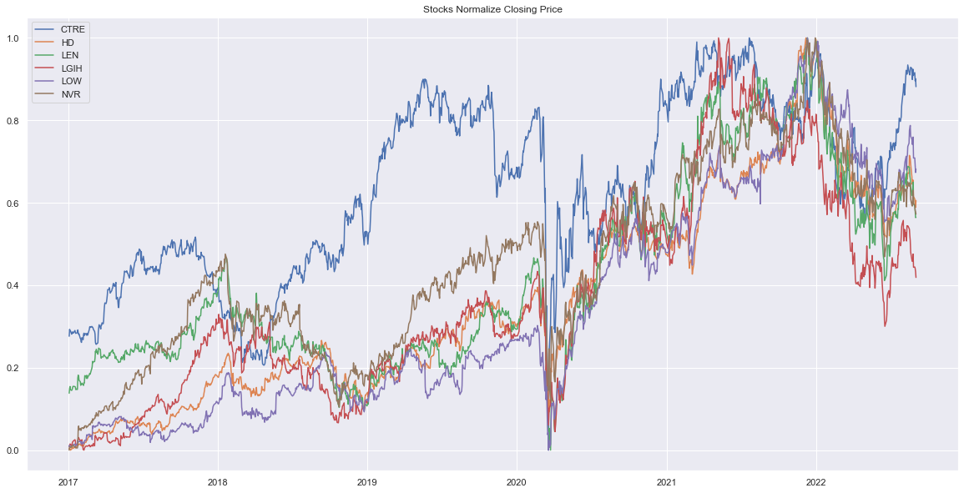
Normalize closing price

Slide 13
Statistics Prices
Ticker | CTRE | HD | LEN | LGIH | LOW | NVR
count | 1427.000000 | 1427.000000 | 1427.000000 | 1427.000000 | 1427.000000 | 1427.000000
mean | 15.779377 | 215.401207 | 63.391666 | 85.073364 | 124.736733 | 3583.308873
std | 3.146521 | 69.387620 | 19.791616 | 38.869061 | 51.521253 | 979.647882
min | 6.437534 | 112.847778 | 27.822523 | 27.400000 | 60.539158 | 1649.989990
25% | 13.228550 | 159.551773 | 48.146530 | 56.945000 | 83.876297 | 2774.145020
50% | 15.873449 | 197.688385 | 55.935699 | 73.959999 | 103.355370 | 3468.149902
75% | 18.632731 | 269.465103 | 77.237392 | 111.910000 | 170.995193 | 4363.700195
max | 21.244001 | 394.975494 | 112.877815 | 183.360001 | 250.096985 | 5959.330078

Slide 14
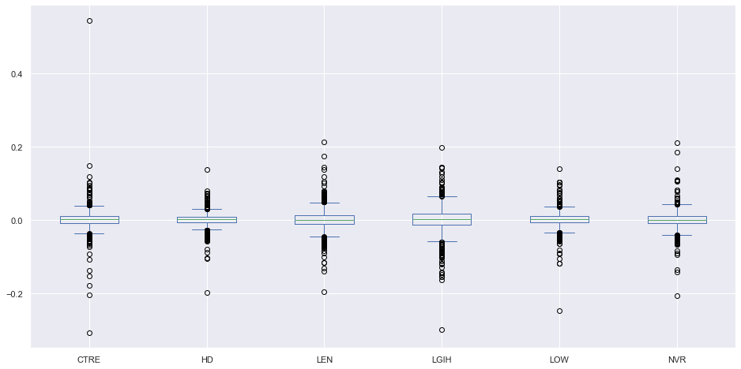
Box Plot

Slide 15
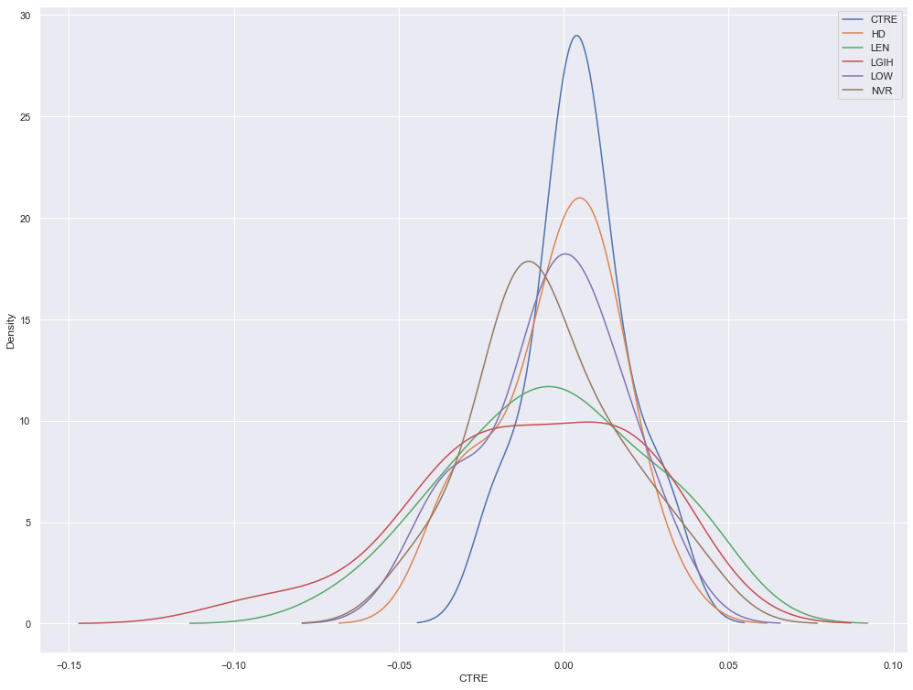
Kernel Distribution Estimation

Slide 16
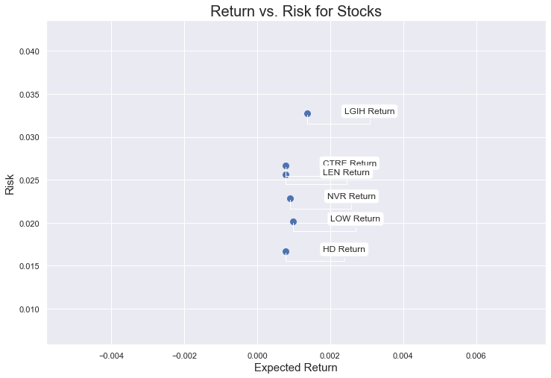
Risk & Returns for Stocks

Slide 17
Conclusion
In conclusion, investing in housing stocks during the COVID-19 pandemic presents several compelling advantages. The resilience of the housing market, driven by low-interest rates, government support, and evolving consumer needs, provides a stable foundation for companies operating in this sector. The essential nature of housing ensures consistent demand, even during economic uncertainty, while increased home improvement spending further boosts the sector's prospects. Additionally, companies specializing in new home construction and rentals stand to benefit from shifting preferences driven by remote work and urban flight. Investing in housing stocks can offer potential for long-term growth, supported by factors like population growth and urbanization trends. Lastly, including housing stocks in an investment portfolio can enhance diversification, mitigating overall portfolio risk. Overall, the combination of these factors makes housing stocks an attractive option for investors looking to capitalize on opportunities amid the COVID-19 pandemic and beyond.

Slide 18
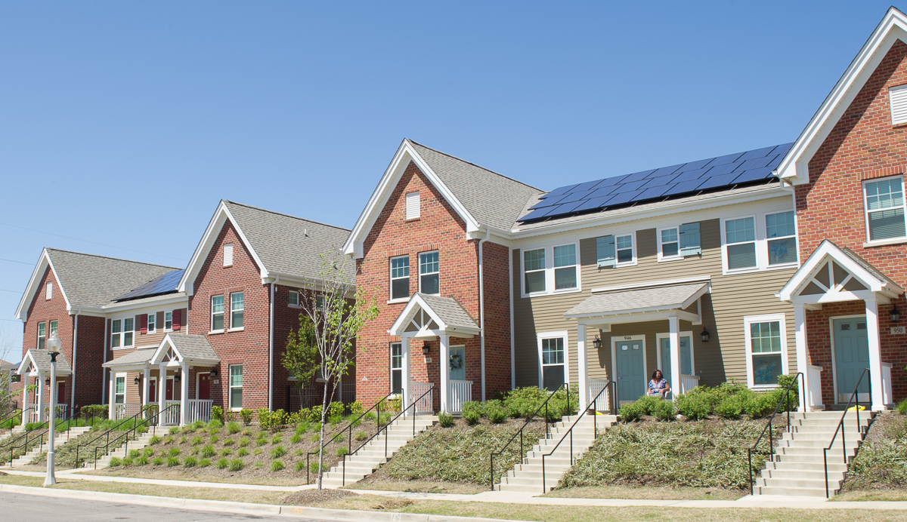
Thank you for taking the time to read through this slide. Your attention and engagement are greatly appreciated. If you have any questions or would like further information, please don't hesitate to reach out. Thank you once again!

